Slide 1






Magentic Agency: A Marketplace Built on Fair Procedure
Revolutionizing fractional ownership by embedding procedural justice as the central operating precept.
PROCEDURAL JUSTICE FRAMEWORK
Commitment to transparency and notice
Non-arbitrary decision making
Protection against unchecked platform power
Equitable access for Users and Experts

Slide 2






Users Access Expertise Through a Transparent Lens
Quality, Reliability, and Fair Pricing
Transparent Access
Auditable Matching
Book 10-minute expert consultations via a matching system with published, auditable criteria.
Quality Assurance
Vetted experts and resources ensure high-value guidance without the risk of unqualified providers.
Fair Pricing
Clear, upfront pricing models prevent hidden fees and discriminatory practices.
User Trust Metric
Dispute Resolution
100% Transparency in Pricing & Rules
Formal mechanisms to address grievances regarding service quality or platform decisions.

Slide 3






Experts Thrive Under the Protection of Fair Procedure
Security, Due Process, and Professional Growth
Livelihood Protection
Due Process Rights
Safeguards against arbitrary expulsion, recognizing the platform's economic power.
Mandatory notice and hearing before any adverse action is taken against an expert.
Transparent Evaluation
Monetization Rights
Ratings based on objective, stated criteria, not opaque "black box" algorithms.
Clear ownership and revenue sharing for all published content and tools.
Procedural Justice Workflow
1
2
3
4
Clear Rules
Notice of Issue
Fair Hearing
Reasoned Decision

Slide 4

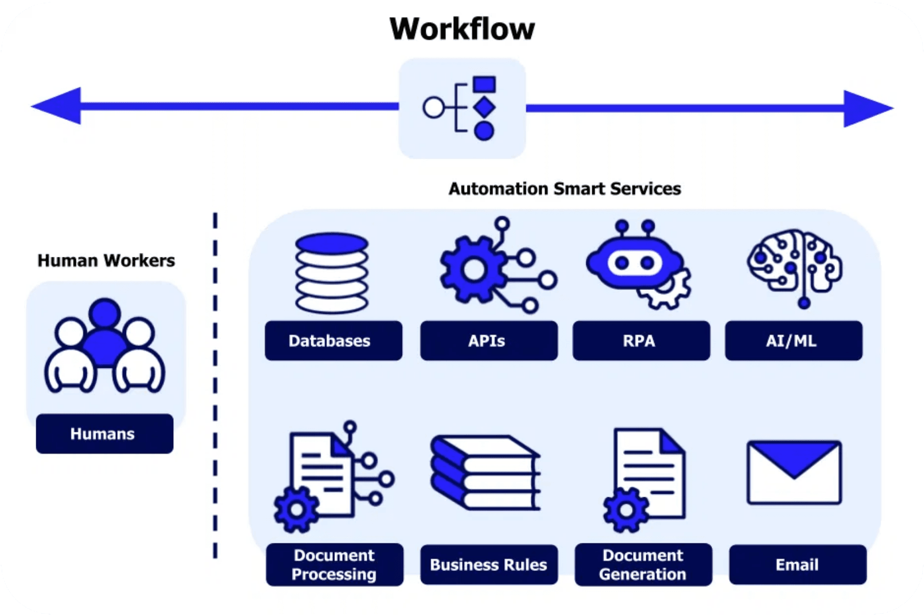




FAIRNESS_ENGINE_ACTIVE
The Butler: An Agent of Procedural Justice
Enforcing Fairness Through Auditable Algorithms
Algorithmic Fairness
Matching and allocation algorithms are designed to be bias-free, transparent, and fully auditable.
Proactive Governance
Continuously monitors platform activity to detect and correct unfair outcomes or procedural breaches.
Automated Accountability
Logs every significant decision (bookings, ratings, disputes) to an immutable audit trail.
FIG 4.0: AUTOMATED GOVERNANCE LAYER > MONITORING TRANSACTIONS FOR COMPLIANCE > ENFORCING PROCEDURAL RULES
Neutral Intermediary
Facilitates exchanges without favoring one side, ensuring a balanced and ethical marketplace.
[LOG] 10:00:01 MATCH_INITIATED [LOG] 10:00:02 BIAS_CHECK_PASSED [LOG] 10:00:03 TRANSACTION_VERIFIED

Slide 5
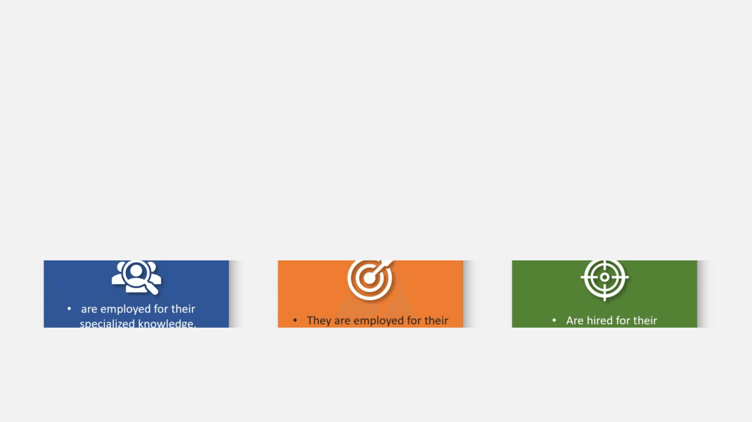
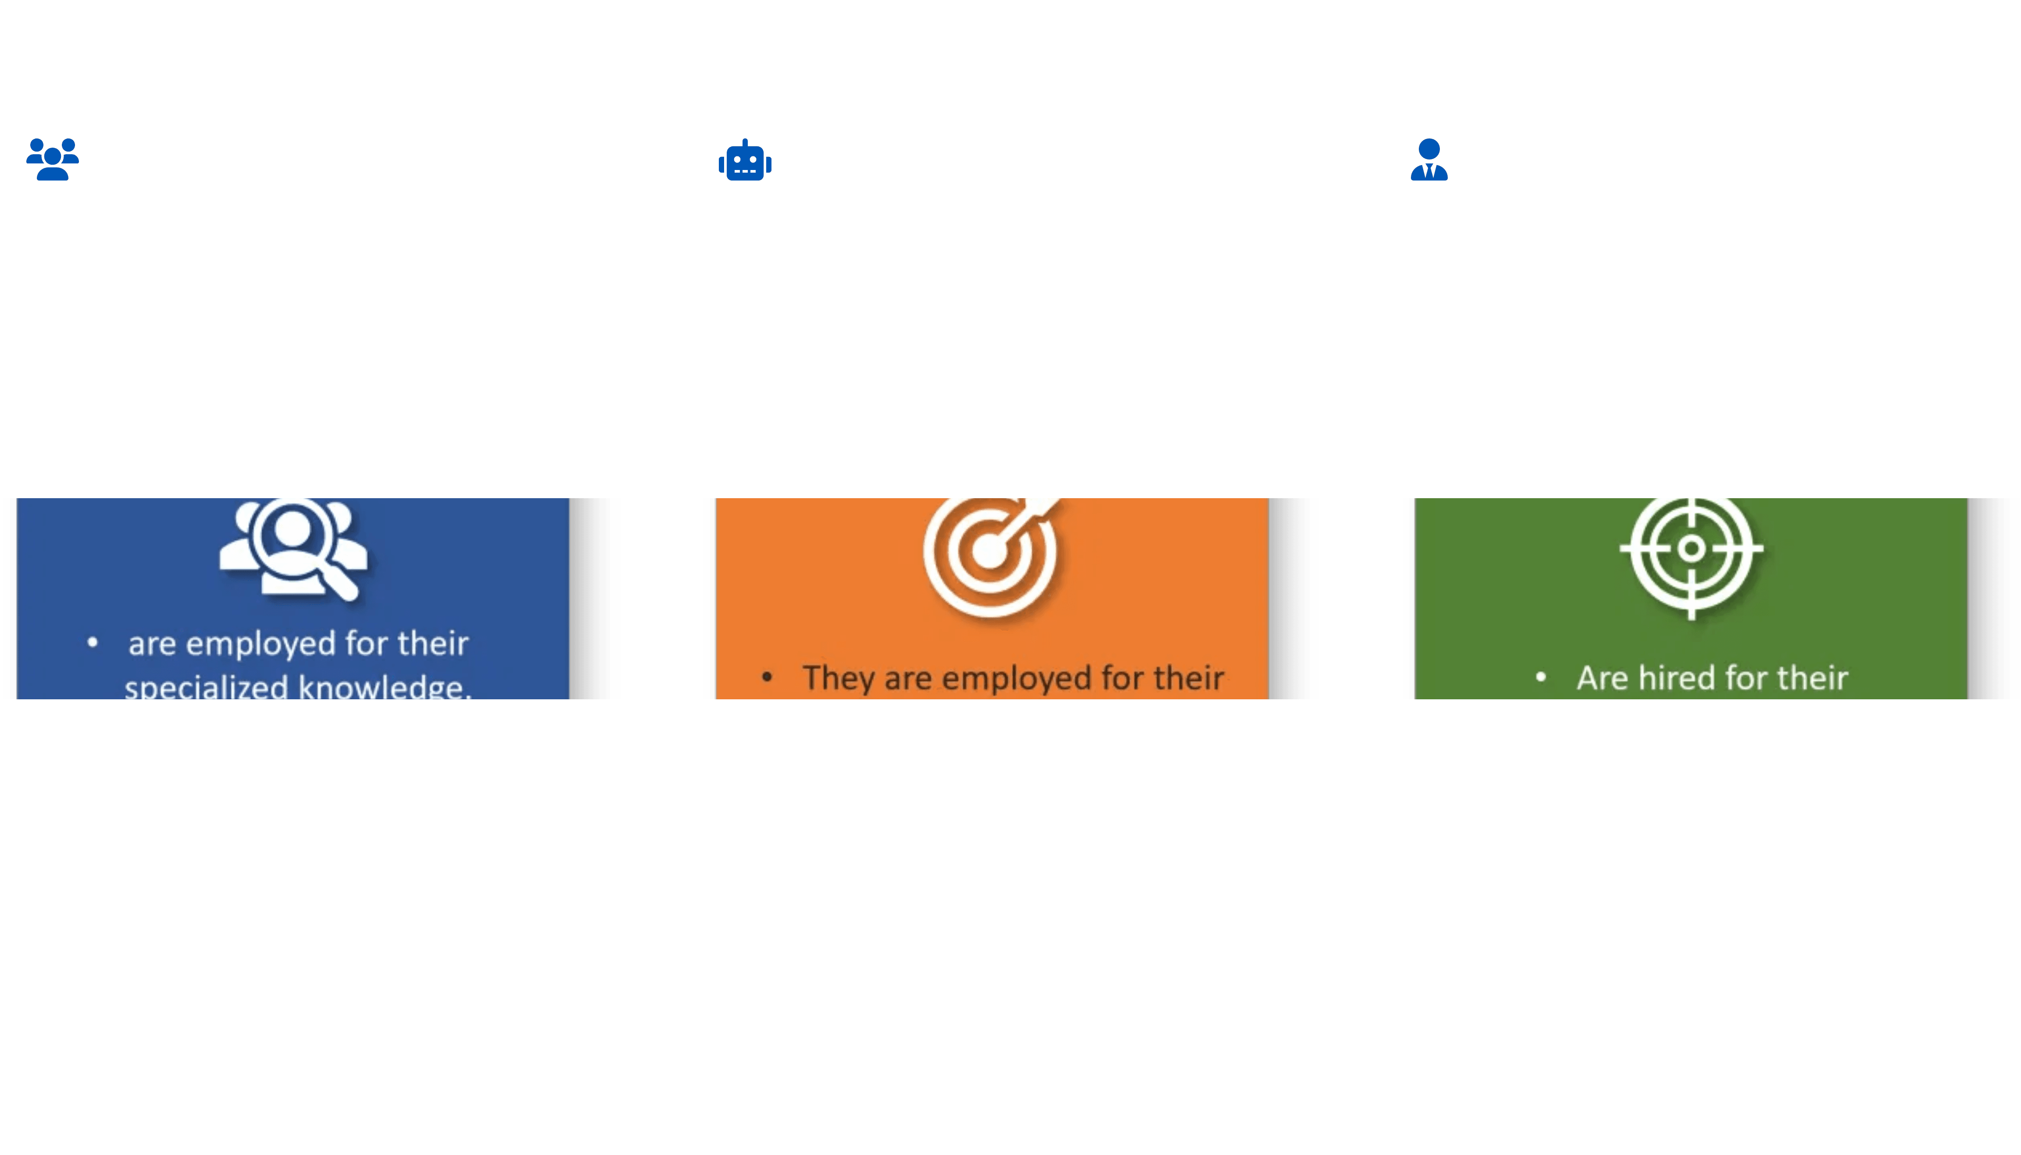



A Sustainable Ecosystem Founded on Trust
Symbiotic Growth: Users, Experts, and the Butler
Users
The Butler
Experts
Trust in platform quality
Impartial arbiter
Economic security
Fair access to resources
Auditable matching
Professional growth
Protected from exploitation
Enforces procedural rules
Protected from arbitrary acts
Fair Procedure drives a self-reinforcing cycle of trust and value creation.

